Slide 1

Department of CSIT
COURSE NAME
FOUNDATIONS OF CLOUD-NATIVE COMPUTING & DEVOPS
COURSE CODE –24CS2260F
Topic:
rollout & rollback hygiene
Session - 5

Slide 2
Why Rollout & Rollback Hygiene Matters
Applications in Kubernetes are frequently updated due to bug fixes, configuration changes, or feature releases.
Without proper rollout hygiene, updates can cause downtime or service disruption.
Rollback hygiene ensures that when failures occur, systems can return quickly to a stable state with minimal impact.

Slide 3
What is a Rollout and Rollback in Kubernetes?
A rollout is the process of deploying a new version of an application. Kubernetes typically manages rollouts using Deployments, which replace old pods with new ones in a controlled manner. This gradual replacement allows Kubernetes to maintain service availability during updates.
A rollback is the process of reverting an application to a previously known stable version when a rollout fails. Kubernetes stores revision history for Deployments, enabling operators to quickly undo failed updates. Rollbacks are critical for handling faulty releases and misconfigurations.

Slide 4
Deployment Update Strategies
Kubernetes Deployments support two main update strategies:
RollingUpdate (default): Gradually replaces old pods with new ones
Recreate: Terminates all old pods before creating new ones
RollingUpdate is preferred in production because it minimizes downtime.

Slide 5
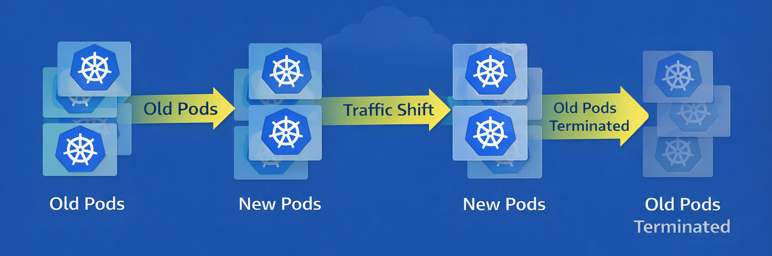
Rolling Update Mechanism
Kubernetes incrementally creates new pods while terminating old ones. Parameters such as maxUnavailable and maxSurge control how many pods can be unavailable or added during the update.

Slide 6
Triggering a Rollout & Monitoring Rollout Progress
A rollout is triggered whenever the Deployment specification changes, such as updating the container image.
Command:
kubectl set image deployment/myapp mycontainer=myapp:v2
This command initiates a controlled rollout of the new application version.
Monitoring rollout status is essential to detect failures early.
Command:
kubectl rollout status deployment/myapp
This command shows whether the rollout is progressing successfully or has encountered issues.

Slide 7
Detecting Rollout Failures
Rollouts may fail due to:
Application crashes
Readiness probe failures
Image pull errors
Resource constraints
Kubernetes pauses the rollout when new pods fail to become ready, preventing further disruption.

Slide 8
Performing a Rollback
If a rollout fails, Kubernetes allows reverting to the previous version easily.
Command:
kubectl rollout undo deployment/myapp
This restores the last stable revision and helps recover service availability quickly.
Rollout History and Revisions
Kubernetes maintains a history of deployment revisions.
Command:
kubectl rollout history deployment/myapp
Operators can inspect previous revisions and roll back to a specific version if required.

Slide 9
Rollout & Rollback Hygiene Best Practices
Always use rolling updates in production
Configure readiness and liveness probes correctly
Monitor logs and metrics during rollouts
Avoid using latest image tags
Retain sufficient revision history
Good hygiene reduces deployment risk.

Slide 10
Common Rollout & Rollback Mistakes
Common mistakes include:
Deploying without monitoring rollout status
Skipping readiness probes
Not testing rollback procedures
Rolling out during peak traffic
These mistakes increase downtime and operational risk.

Slide 11
Summary
Rollout and rollback hygiene ensures safe application updates and rapid recovery from failures.
Kubernetes Deployments provide built-in mechanisms for rolling updates and rollbacks.
By following best practices and monitoring deployments carefully, operators can maintain stable and production-ready Kubernetes environments.

Slide 12

THANK YOU
Team –Foundations Of Cloud-native Computing & Devops

